Slide 1



Slide 2



Build a Canvas application with Azure Cognitive Services

Slide 3
Muralidharan Deenathayalan
Associate Director - Software Innovation, Quanticate
www.quanticate.com
Blog : www.codingfreaks.net
Git : https://github.com/muralidharand
Twitter : https://twitter.com/muralidharand
LinkedIn : https://www.linkedin.com/in/muralidharand

Slide 4
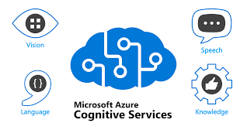
Agenda
What is Azure Cognitive Services
Pillars of Azure Cognitive Services
Speech API
Language API
Visions API
Decision API
Demo
Create and Configure Language Services
Create Connection in Power Automate
Create PowerApp – Canvas App

Slide 5
Speech API
Speech to Text
Transcribe audible speech into readable, searchable text.
Text to Speech
Convert text to lifelike speech for more natural interfaces.
Speech Translation
Integrate real-time speech translation into your apps.
Speaker Recognition
Identify and verify the people speaking based on audio.

Slide 6
Languages API
Entity recognition
Identify commonly-used and domain-specific terms.
Sentiment analysis
Automatically detect sentiments and opinions from text.
Question Answering
Distill information into easy-to-navigate questions and answers.
Conversational language understanding (Preview)
Enable your apps to interact with users through natural language.
Translator
Detect and translate more than 100 supported languages and dialects.

Slide 7
Visions API
Identify and analyze content within images and videos
Computer Vision
Analyze content in images and video.
Custom Vision
Customize image recognition to fit your business needs.
Face API
Detect and identify people and emotions in images.

Slide 8
Decisions API
Make smarter decisions faster
Anomaly Detector
Identify potential problems early on.
Content Moderator
Detect potentially offensive or unwanted content.
Personalizer
Create rich, personalized experiences for every user.

Slide 9

Demo

Slide 10
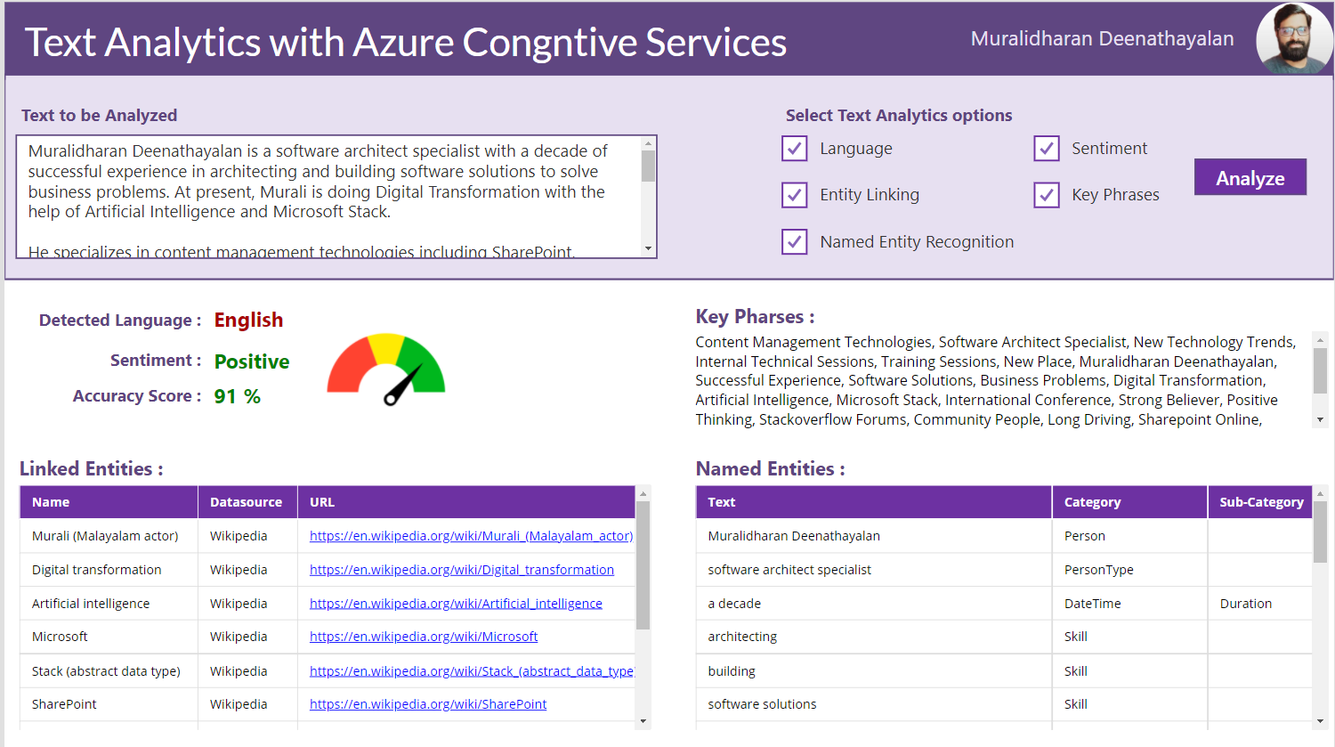
Demo

Slide 11
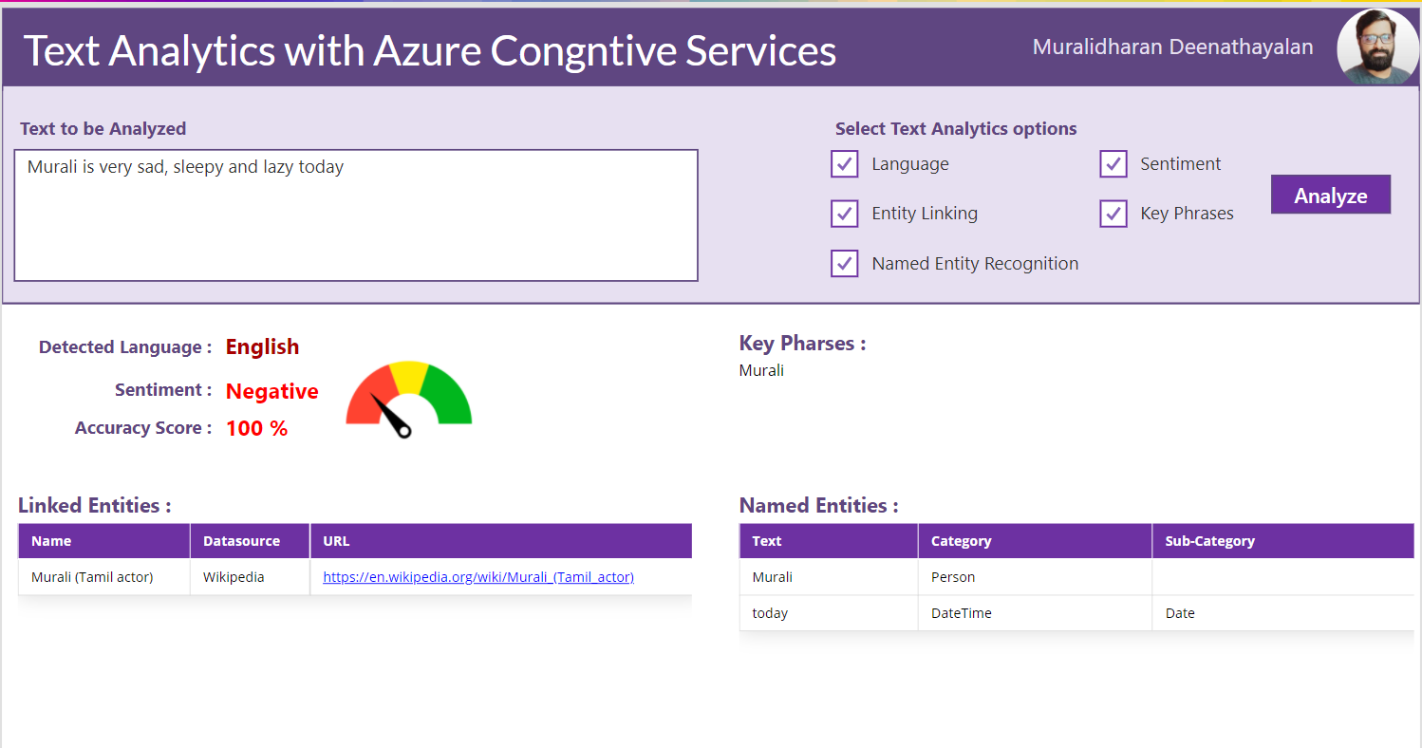
Demo

Slide 12
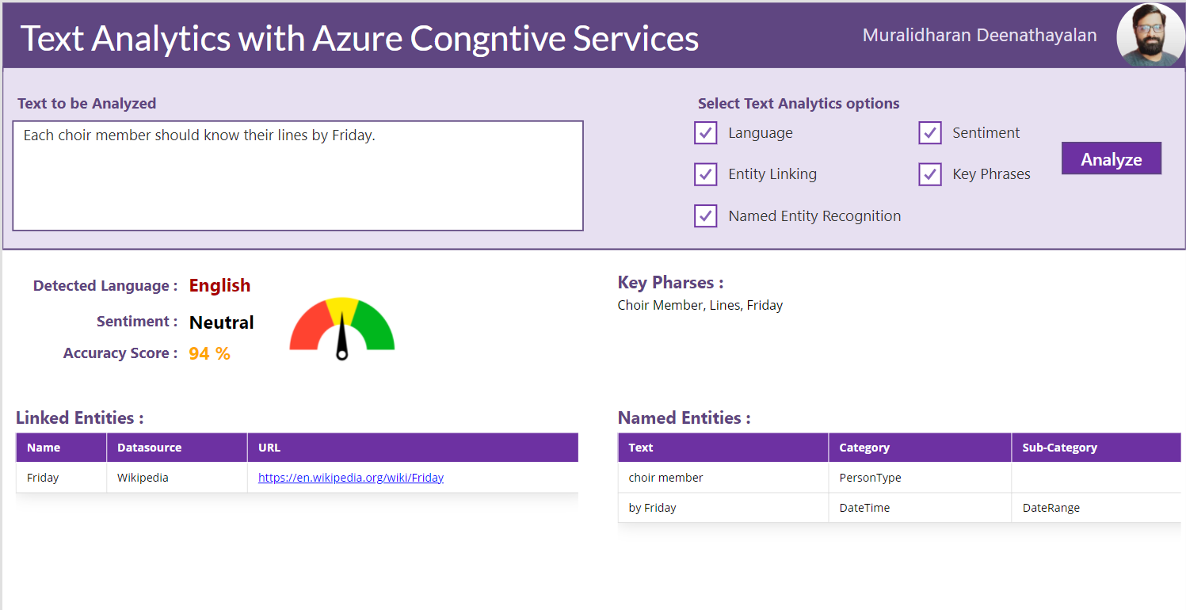
Demo

Slide 13

Q & A

Slide 14
Thanks for joining!

